Slide 1
Hospital Management System
PRESENTED BY
PRAGATI DIVEKAR

Slide 2

BRIEF OVERVIEW
A hospital management system helps manage the information related to health care and aids in the job completion of health care providers effectively.
HMS was introduced to solve the complications arising from managing all the paperwork of every patient associated with the various departments of hospitalization with confidentiality.
HMS provides the ability to track and record all the paperwork in one place, reducing manual effort in arranging and analyzing the patients' paperwork.
HMS can help in many areas like:
Maintain the medical records of the patient
Maintain the contact details of the patient
Keep track of the appointment dates
Save the insurance information for later reference
Tracking the bill payments.
Maintain a proper flow of all the details involved with
a HMS.

Slide 3
MODULES & TABLES
Patient Management
Employee Management
Stock Management
Patient_T
PatientRegister_T
PatientDisease_T
PatientVitals_T
Ward_T
Room_T
Disease_T
Donor
TrackDonorPatient
PatientAuditLog
Cafeteria_T
Department_T
Employee_T
Doctor_T
Payroll_T
Inventory_T
Pharmacy_T
Laboratory_T

Slide 4
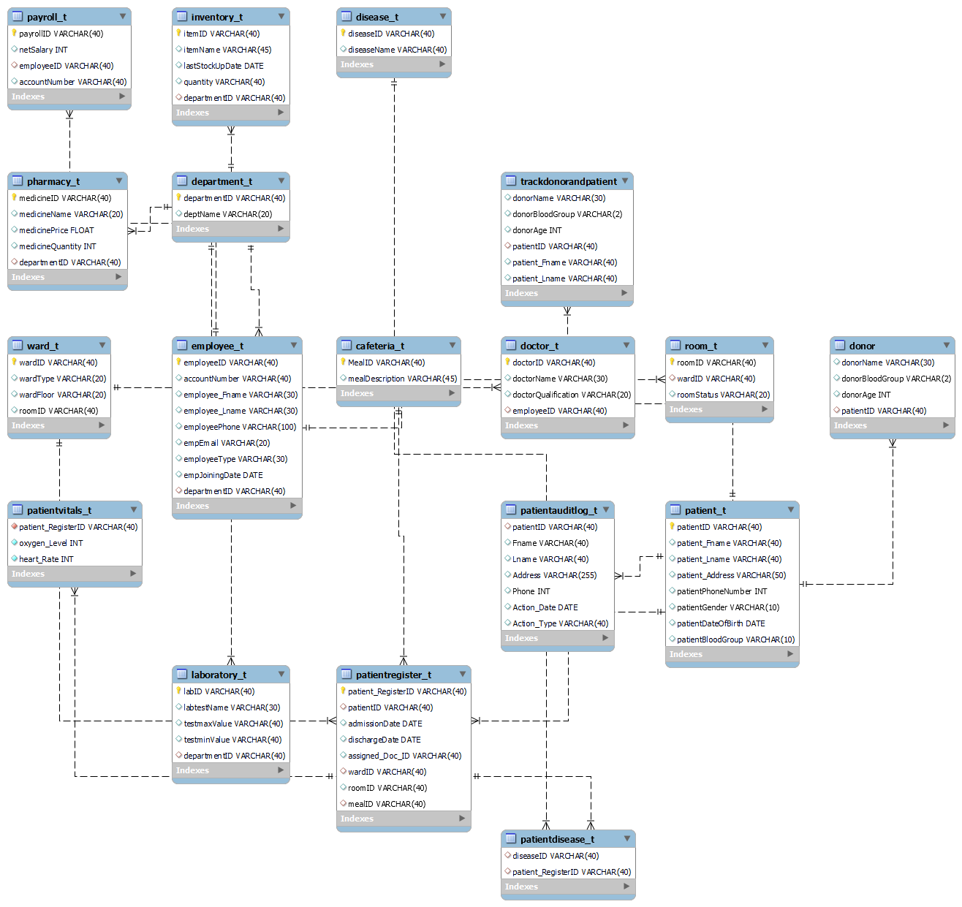
REVERSE ENGINEER / BLUEPRINT

Slide 5
STORED FUNCTIONS
Patient_Age_Category: This function sorts patients into 3 different categories based on their age: ‘Child’ for 0-14 yrs, ‘Adult’ for 14-60 yrs and ‘Senior Citizen’ for everyone above 60. The Patient_Age is first calculated in the Patient table from the D.O.B as per record. When this age is input into the function, it returns the respective Age Category for the patient.
Patient_Room_Rate: To calculate the tariff for the patient’s room based on the number of days admitted, we extract the duration the patient was admitted for, from the Patient Register table (Discharge Date-Admission Date). The per day rate is based on the number of days the patient was admitted for. 2500 for >20 days, 3000 for 10-20 days, 4000 for 1-9 days and 5000 if the duration is less than a day.
Patient_Discounted_Bill: The Room bill of each patient is calculated (Duration*Room Rate). This function applies discounts on the total bill. A 30% discount for bills >100000, 20% for bills ranging between 75000 to 100000 and 10% for bill amounts between 25000 and 75000.

Slide 6
TRIGGERS
Check_Quantity: The Check_Quantity trigger is designed to flash an error message “Refill Stock” when the medicine quantities are updated to a value less than 1000. This ensures that the hospital never runs out of critical medicines, especially during emergencies.
Archive_Donor_Patient: This Trigger stores the combined values of the Patient as well as the Donor whenever an Insert operation is performed on the donor table. It fetches the corresponding values from patient table via Patient ID and stores it in the archive table.
Monitor_Oxygen_Level & Monitor_HeartRate: The Patient_Vitals table records the Oxygen Level and Heart Rate of all currently admitted patients. These two triggers will be useful in alerting the hospital staff when a patient's vitals fall below/above the normal thresholds. This trigger also identifies the doctor assigned to that specific patient using complex join and subqueries, and reflects on the error message “ Patient “Alaya Critical, Call Doc_Name”.

Slide 7
STORED PROCEDURES
Max_Disease_Occurence: This procedure will help us find the disease that is being occured to most number of patients. We are using the MAX &COUNT functions to calculate this value from Patient Disease table and then inserting that into the Patient Register table to get all the names. Such information is vital when dealing with highly infectious conditions such as COVID.
Update_Room_Status: Through this procedure, we would be updating the room status (Occupied/Vacant) in the Room Table, each time a new patient is admitted and assigned to a new room in the “Patient Register Table”. This will help reduce manual work of of the Admin team, as updates take place on real time basis.
Employee_Bonus: This procedure is used to add a bonus percent that is specified by the HR department for employees that have started in the company for a tenure greater than 10 years. We are using DATEDIFF functions and JOINS inside the SP.
Employee_SalaryRange:The following procedure finds the name of those employees whose salary is greater than a specified range of value. It is used to find out the employees who are under or above a certain range.

Slide 8
VIEWS
Patient_Ordinary_Data: Information about the patients like the patient ID , patient name , date of admission etc is showcased in this View. This helps the user to get a general overview of the hospital management system .
Patient_Sensitive_Data: This view contains classified information about the patients like the patient's phone number, date of birth, disease the patient is suffering from etc. Such information requires additional clearance and is not generally accessible by others.
Employee_Sensitive_Data: This contains classified information about all the employees working at the hospital like Employee ID, Account number, net salary etc. All this information is private, and its access should be restricted to a limited number of people. Thus this view helps in doing the same.

Slide 9
THANK YOU!
Any Questions?

